Slide 1
CANTILEVER BEAM
MODAL ANALYSIS

Slide 2
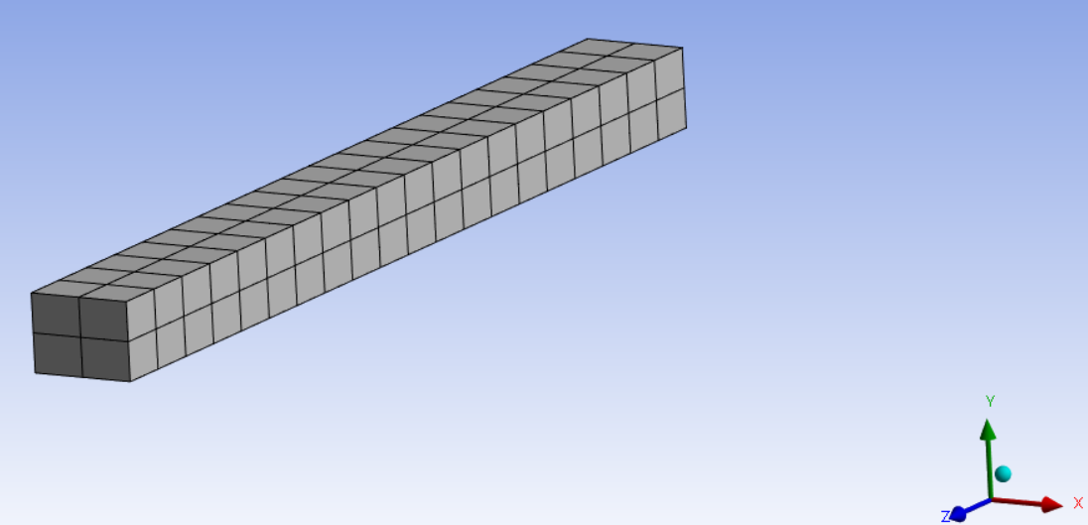
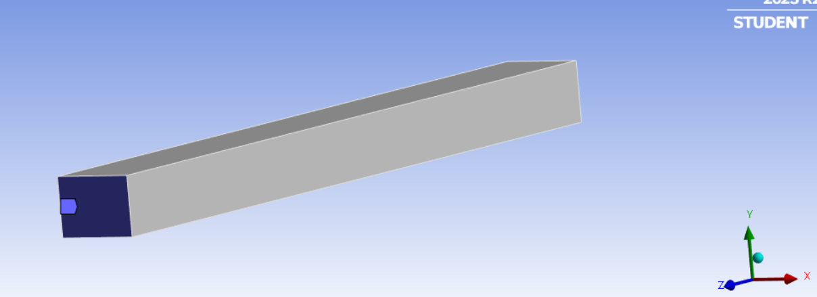
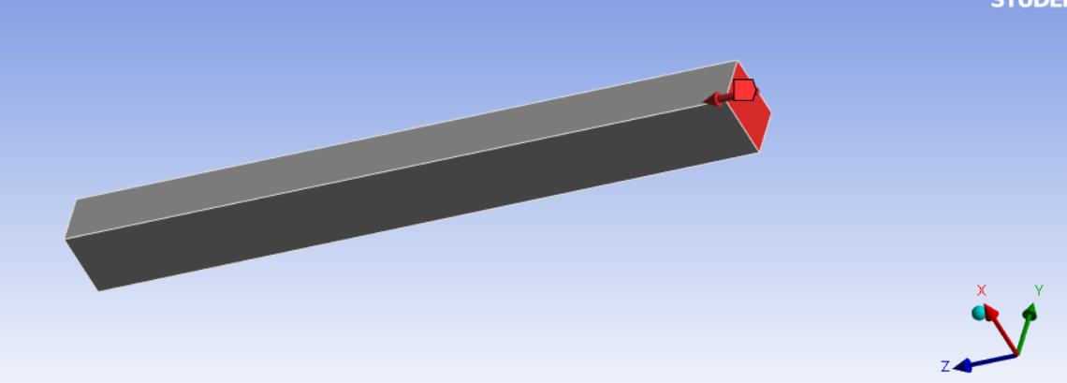
GEOMETRY
Dimensions :
X axis – 20cm
Y axis – 15cm
Z axis – 200cm
No. of elements in mesh – 2x2x20
=80
Fixed Support (z-axis)
Force (z-axis) - (0,0,1000N)

Slide 3
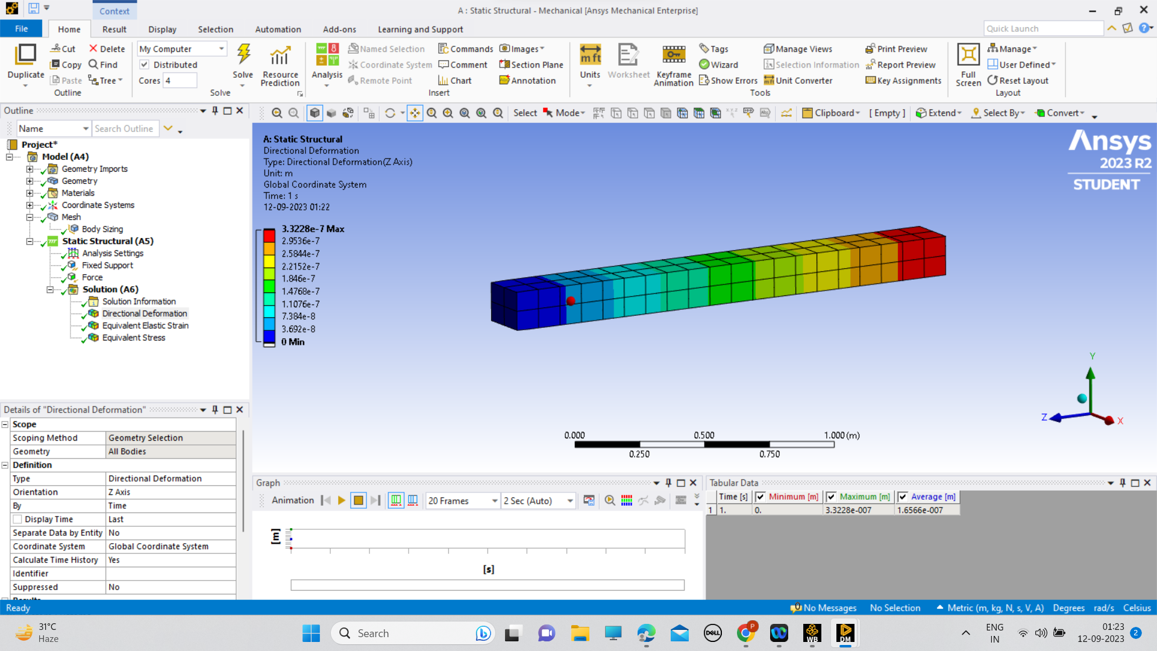
DIRECTIONAL DEFORMATION

Slide 4
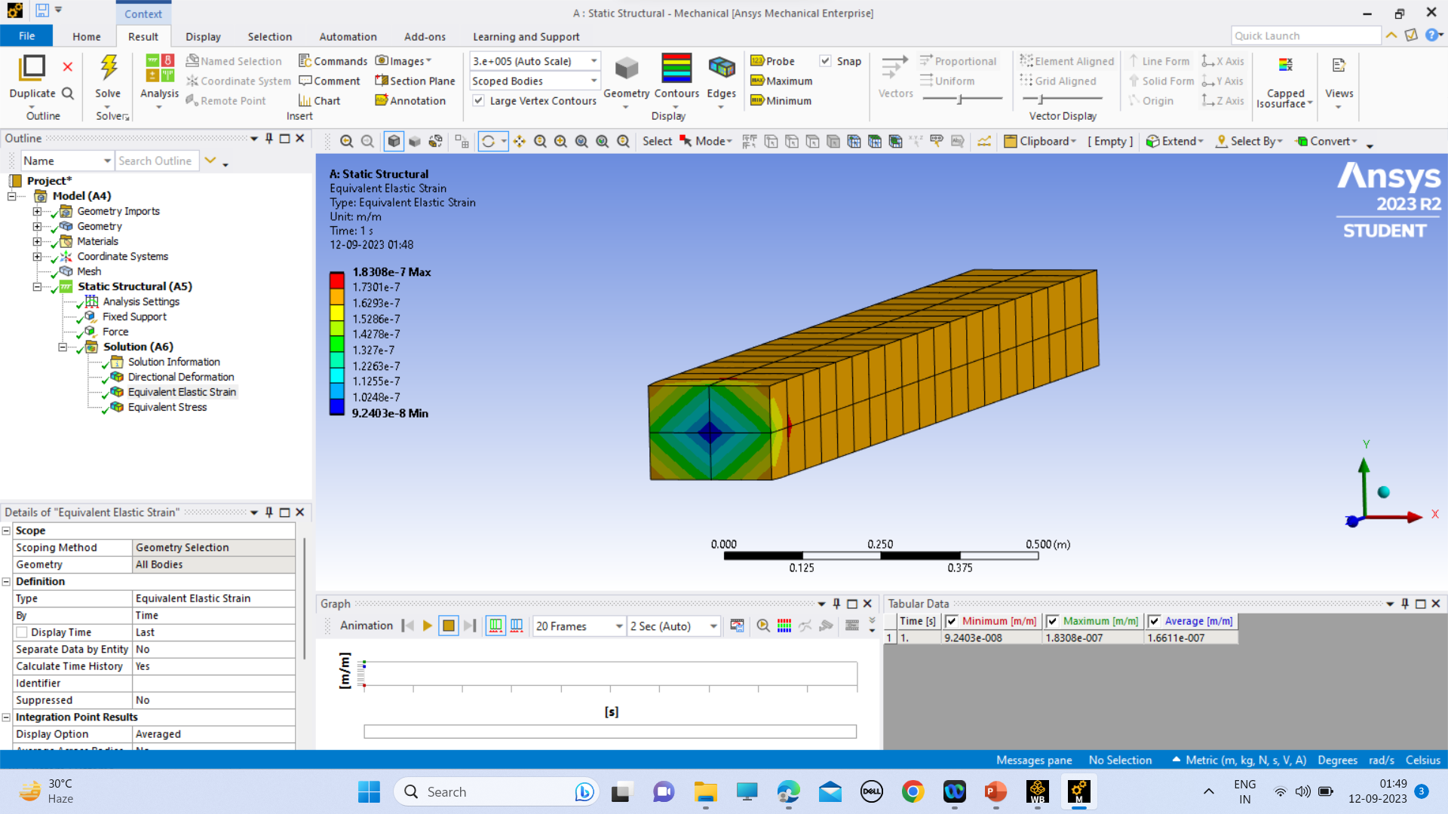
EQUIVALENT ELASTIC STRAIN

Slide 5
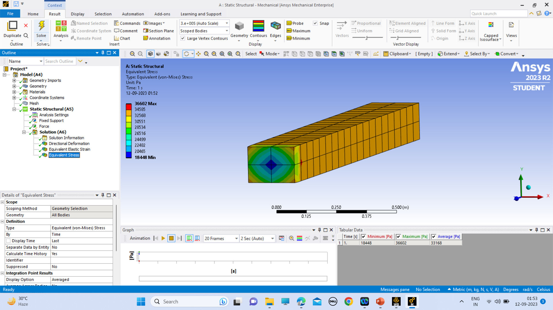
EQUVALENT STRESS

Slide 6
RESULT
 | MINIMUM | MAXIMUM | AVERAGE
DIRECTIONAL DEFORMATION (m) | 0. | 3.3228e-007 | 1.6566e-007
EQUIVALENT ELASTIC STRAIN (m/m) | 9.2403e-008 | 1.8308e-007 | 1.6611e-007
EQUVALENT STRESS (Pa) | 18448 | 36602 | 33168

